Slide 1
Implementing Authentication

Slide 2
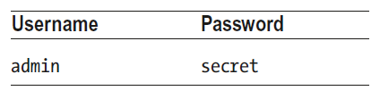
Understanding the Authentication System
When the RESTful web service authenticates a user, it will return a JSON Web Token (JWT) that the application must include in subsequent HTTP requests to show that authentication has been successfully performed.
For the SportsStore application, the Angular application can authenticate the user by sending a POST request to the /login URL, including a JSON-formatted object in the request body that contains name and password properties.
There is only one set of valid credentials in the authentication code we added to the application in an earlier lesson, which is shown in the following table.

Slide 3
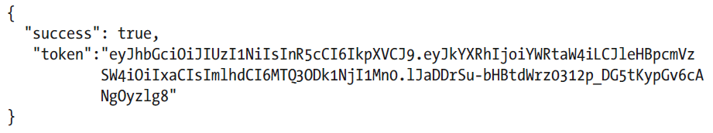
Understanding the Authentication System (continued)
If the correct credentials are sent to the /login URL, then the response from the RESTful web service will contain a JSON object like this:
The success property describes the outcome of the authentication operation, and the token property contains the JWT, which should be included in subsequent requests using the Authorization HTTP header in this format:

Slide 4

Understanding the Authentication System (continued)
We configured the JWT tokens returned by the server so they expire after one hour.
If the wrong credentials are sent to the server, then the JSON object returned in the response will just contain a success property set to false, like this:

Slide 5
Extending the Data Source
The RESTful data source will do most of the work because it is responsible for sending the authentication request to the /login URL and including the JWT in subsequent requests.
The following code listing adds authentication to the rest.datasource.ts file in the src/app/model folder and defines a variable that will store the JWT once it has been obtained.
import { Injectable } from "@angular/core";
import { HttpClient } from "@angular/common/http";
import { Observable } from "rxjs";
import { Product } from "./product.model";
import { Cart } from "./cart.model";
import { Order } from "./order.model";
import { map } from "rxjs/operators";
const PROTOCOL = "http";
const PORT = 3500;
@Injectable()
export class RestDataSource {
baseUrl: string;
auth_token: string;

Slide 6
Extending the Data Source (continued)
constructor(private http: HttpClient) {
this.baseUrl = `${PROTOCOL}://${location.hostname}:${PORT}/`;
}
getProducts(): Observable<Product[]> {
return this.http.get<Product[]>(this.baseUrl + "products");
}
saveOrder(order: Order): Observable<Order> {
return this.http.post<Order>(this.baseUrl + "orders", order);
}
authenticate(user: string, pass: string): Observable<boolean> {
return this.http.post<any>(this.baseUrl + "login", {
name: user, password: pass
}).pipe(map(response => {
this.auth_token = response.success ? response.token : null;
return response.success;
}));
}
}

Slide 7
Creating the Authentication Service
Rather than expose the data source directly to the rest of the application, we are going to create a service that can be used to perform authentication and determine whether the application has been authenticated.
We will add a file called auth.service.ts in the src/app/model folder and add the following code:
import { Injectable } from "@angular/core";
import { Observable } from "rxjs";
import { RestDataSource } from "./rest.datasource";
@Injectable()
export class AuthService {
constructor(private datasource: RestDataSource) {}
authenticate(username: string, password: string): Observable<boolean> {
return this.datasource.authenticate(username, password);
}
get authenticated(): boolean {
return this.datasource.auth_token != null;
}
clear() {
this.datasource.auth_token = null;
}
}

Slide 8
Creating the Authentication Service (continued)
The authenticate method receives the user’s credentials and passes them on to the data source authenticate method, returning an Observable that will return true if the authentication process has succeeded and false otherwise.
The authenticated property is a getter-only property that returns true if the data source has obtained an authentication token.
The clear method removes the token from the data source.

Slide 9
Creating the Authentication Service (continued)
The following code Listing registers the new service with the model feature module.
It also adds a providers entry for the RestDataSource class, which has been used only as a substitute for the StaticDataSource class in earlier lessons.
Configure the AuthService in the model.module.ts file in the src/app/model folder:
import { NgModule } from "@angular/core";
import { ProductRepository } from "./product.repository";
import { StaticDataSource } from "./static.datasource";
import { Cart } from "./cart.model";
import { Order } from "./order.model";
import { OrderRepository } from "./order.repository";
import { RestDataSource } from "./rest.datasource";
import { HttpClientModule } from "@angular/common/http";
import { AuthService } from "./auth.service";
@NgModule({
imports: [HttpClientModule],
providers: [ProductRepository, Cart, Order, OrderRepository,
{ provide: StaticDataSource, useClass: RestDataSource },
RestDataSource, AuthService]
})
export class ModelModule { }

Slide 10
Enabling Authentication
The next step is to wire up the component that obtains the credentials from the user so that it will perform authentication through the new service, as shown in the auth.component.ts file in the src/app/admin folder:
import { Component } from "@angular/core";
import { NgForm } from "@angular/forms";
import { Router } from "@angular/router";
import { AuthService } from "../model/auth.service";
@Component({
templateUrl: "auth.component.html"
})
export class AuthComponent {
public username: string;
public password: string;
public errorMessage: string;
constructor(private router: Router,
private auth: AuthService) { }

Slide 11
Enabling Authentication (continued)
authenticate(form: NgForm) {
if (form.valid) {
this.auth.authenticate(this.username, this.password)
.subscribe(response => {
if (response) {
this.router.navigateByUrl("/admin/main");
}
this.errorMessage = "Authentication Failed";
})
} else {
this.errorMessage = "Form Data Invalid";
}
}
}

Slide 12
Enabling Authentication (continued)
To prevent the application from navigating directly to the administration features, which will lead to HTTP requests being sent without a token, we need to add a file called auth.guard.ts in the src/app/admin folder with the following code:
import { Injectable } from "@angular/core";
import { ActivatedRouteSnapshot, RouterStateSnapshot, Router } from "@angular/router";
import { AuthService } from "../model/auth.service";
@Injectable()
export class AuthGuard {
constructor(private router: Router,
private auth: AuthService) { }
canActivate(route: ActivatedRouteSnapshot, state: RouterStateSnapshot): boolean
{
if (!this.auth.authenticated) {
this.router.navigateByUrl("/admin/auth");
return false;
}
return true;
}
}

Slide 13
Enabling Authentication (continued)
The following code listing applies the route guard to one of the routes defined by the administration feature module. Modify the admin.module.ts file in the src/app/admin folder with the following code:
import { NgModule } from "@angular/core";
import { CommonModule } from "@angular/common";
import { FormsModule } from "@angular/forms";
import { RouterModule } from "@angular/router";
import { AuthComponent } from "./auth.component";
import { AdminComponent } from "./admin.component";
import { AuthGuard } from "./auth.guard";
let routing = RouterModule.forChild([
{ path: "auth", component: AuthComponent },
{ path: "main", component: AdminComponent, canActivate: [AuthGuard] },
{ path: "**", redirectTo: "auth" }
]);
@NgModule({
imports: [CommonModule, FormsModule, routing],
providers: [AuthGuard],
declarations: [AuthComponent, AdminComponent]
})
export class AdminModule {}

Slide 14
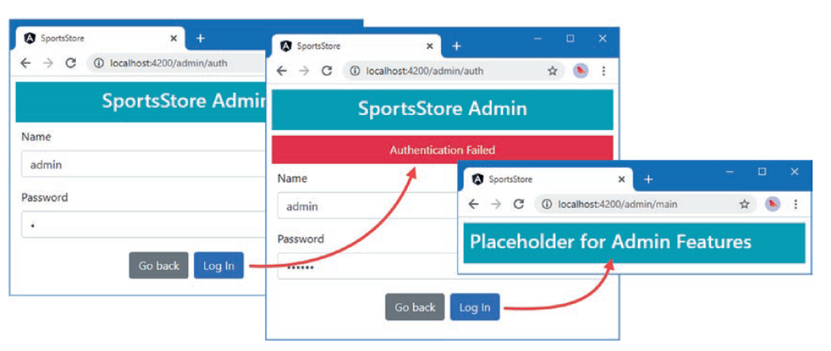
Enabling Authentication (continued)
To test the authentication system, click the Admin button, enter some credentials, and click the Log In button. If the credentials are correct, then you will see the placeholder for the administration features. If you enter other credentials, you will see an error message.

Slide 15
Extending the Data Source and Repositories
With the authentication system in place, the next step is to extend the data source so that it can send authenticated requests and to expose those features through the order and product repository classes. Add the following code to the rest.datasource.ts file in the src/app/model folder:
import { Injectable } from "@angular/core";
import { HttpClient } from "@angular/common/http";
import { Observable } from "rxjs";
import { Product } from "./product.model";
import { Cart } from "./cart.model";
import { Order } from "./order.model";
import { map } from "rxjs/operators";
import { HttpHeaders } from '@angular/common/http’;
...
saveProduct(product: Product): Observable<Product> {
return this.http.post<Product>(this.baseUrl + "products", product,
this.getOptions());
}
updateProduct(product): Observable<Product> {
return this.http.put<Product>(`${this.baseUrl}products/${product.id}`, product,
this.getOptions());
}

Slide 16
Extending the Data Source and Repositories (continued)
deleteProduct(id: number): Observable<Product> {
return this.http.delete<Product>(`${this.baseUrl}products/${id}`,
this.getOptions());
}
getOrders(): Observable<Order[]> {
return this.http.get<Order[]>(this.baseUrl + "orders", this.getOptions());
}
deleteOrder(id: number): Observable<Order> {
return this.http.delete<Order>(`${this.baseUrl}orders/${id}`,
this.getOptions());
}
updateOrder(order: Order): Observable<Order> {
return this.http.put<Order>(`${this.baseUrl}orders/${order.id}`,
order, this.getOptions());
}
private getOptions() {
return {
headers: new HttpHeaders({"Authorization": `Bearer<${this.auth_token}>`})
}
}
}

Slide 17
Extending the Data Source and Repositories (continued)
Modify the product.repository.ts file in the src/app/model folder to support the changes above.
import { Injectable } from "@angular/core";
import { Product } from "./product.model";
//import { StaticDataSource } from "./static.datasource";
import { RestDataSource } from "./rest.datasource";
@Injectable()
export class ProductRepository {
private products: Product[] = [];
private categories: string[] = [];
constructor(private dataSource: RestDataSource) {
dataSource.getProducts().subscribe(data => {
this.products = data;
this.categories = data.map(p => p.category)
.filter((c, index, array) => array.indexOf(c) == index).sort();
});
}

Slide 18
Extending the Data Source and Repositories (continued)
getProducts(category: string = null): Product[] {
return this.products.filter(p => category == null || category == p.category);
}
getProduct(id: number): Product {
return this.products.find(p => p.id == id);
}
getCategories(): string[] {
return this.categories;
}
saveProduct(product: Product) {
if (product.id == null || product.id == 0) {
this.dataSource.saveProduct(product)
.subscribe(p => this.products.push(p));
} else {
this.dataSource.updateProduct(product)
.subscribe(p => {
this.products.splice(this.products.
findIndex(p => p.id == product.id), 1, product);
});
}
}
deleteProduct(id: number) {
this.dataSource.deleteProduct(id).subscribe(p => {
this.products.splice(this.products.
findIndex(p => p.id == id), 1);
})
}
}

Slide 19
Extending the Data Source and Repositories (continued)
The following code listing makes the corresponding changes to the order repository, adding methods that allow orders to be modified and deleted. Modify the order.repository.ts file in the src/app/model folder:
import { Injectable } from "@angular/core";
import { Observable } from "rxjs";
import { Order } from "./order.model";
//import { StaticDataSource } from "./static.datasource";
import { RestDataSource } from "./rest.datasource";
@Injectable()
export class OrderRepository {
private orders: Order[] = [];
private loaded: boolean = false;
constructor(private dataSource: RestDataSource) { }
loadOrders() {
this.loaded = true;
this.dataSource.getOrders()
.subscribe(orders => this.orders = orders);
}

Slide 20
Extending the Data Source and Repositories (continued)
getOrders(): Order[] {
if (!this.loaded) {
this.loadOrders();
}
return this.orders;
}
saveOrder(order: Order): Observable<Order> {
return this.dataSource.saveOrder(order);
}
updateOrder(order: Order) {
this.dataSource.updateOrder(order).subscribe(order => {
this.orders.splice(this.orders.
findIndex(o => o.id == order.id), 1, order);
});
}
deleteOrder(id: number) {
this.dataSource.deleteOrder(id).subscribe(order => {
this.orders.splice(this.orders.findIndex(o => id == o.id), 1);
});
}
}

